Slide 1
Analysis for opening a new Asian Restaurant

Slide 2
Choosing right location for opening new Asian Restaurant in Toronto
Prior launching any restaurant, it is important to know if the business has a good opportunity. The factors we have to take into consideration are as follows,
Market Places
Competition in particular location
Aiding places that make people come to restaurants like Gym, Entertaining Public places
Population
Menu from competitors
Income of people residing in the neighbourhood

Slide 3
Data Acquisition and Cleaning
Data for neighbourhoods and boroughs https://en.wikipedia.org/wiki/List_of_postal_codes_of_Canada:_M
Data for longitude-latitude coordinates of neighbourhoods https://cf-courses-data.s3.us.cloud-object-storage.appdomain.cloud/IBMDeveloperSkillsNetwork-DS0701EN-SkillsNetwork/labs_v1/Geospatial_Coordinates.csv
‘BeautifulSoup’ library is used to extract data, and this data is stored in dataframe
‘Foursquare API’ is used to locate all venues for the neighbourhoods in Toronto.
In total, there are 2111 rows and 8 columns in raw data.
Data is pre-processed; duplicate data, unnecessary data is dropped and the dataframes are merged to obtain the required dataframe.

Slide 4
Data Analysis and Data Visualization
matplotlib.pyplot library is used to plot the graphs based on the data analysis.
Folium map is used to plot the map of all the restaurants data and Asian restaurants data which helps with visualization.

Slide 5
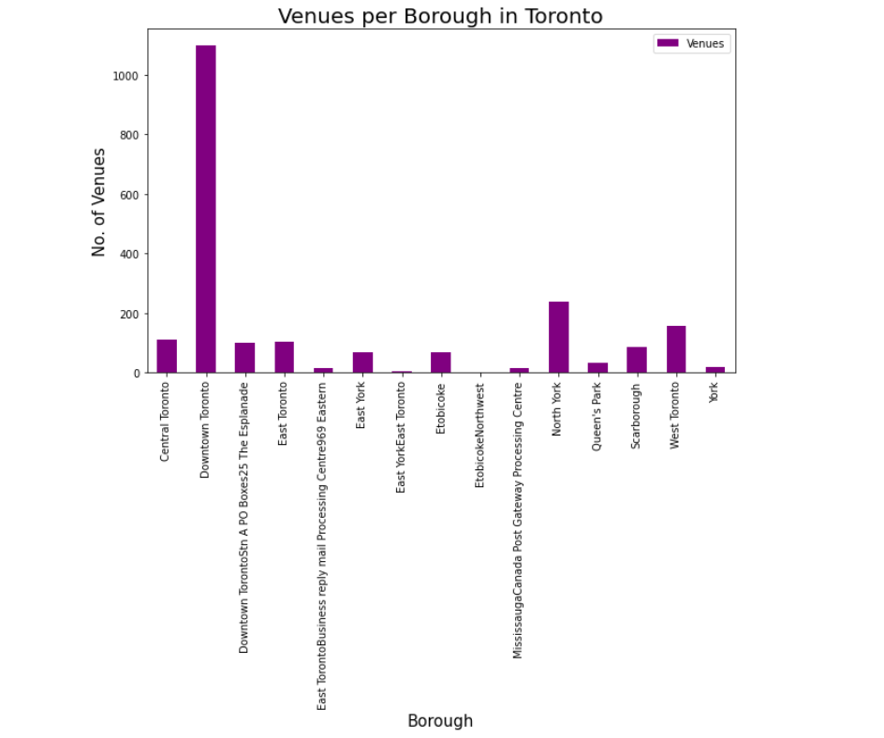
Number of Venues per Borough
Downtown Toronto is the most popular borough in Toronto with maximum number of venues located while Etobicoke is the least popular.

Slide 6
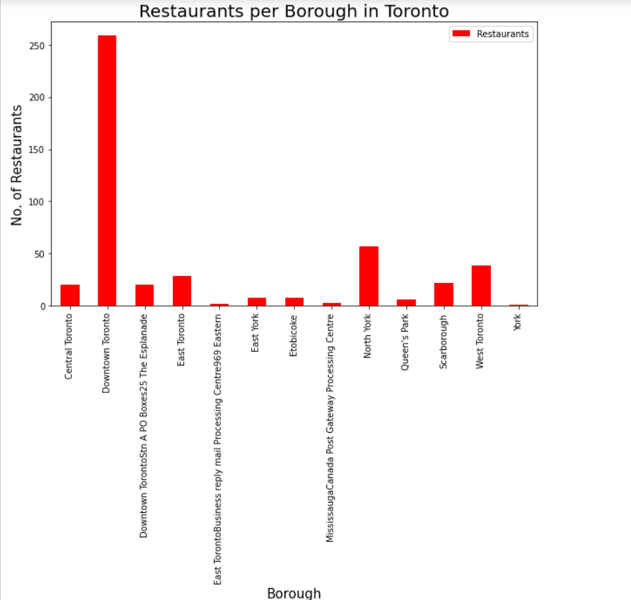
Number of Restaurants per Borough
Downtown Toronto is the most popular borough in Toronto; it has multiple attractions and hence it is expected to have variety of restaurants.

Slide 7
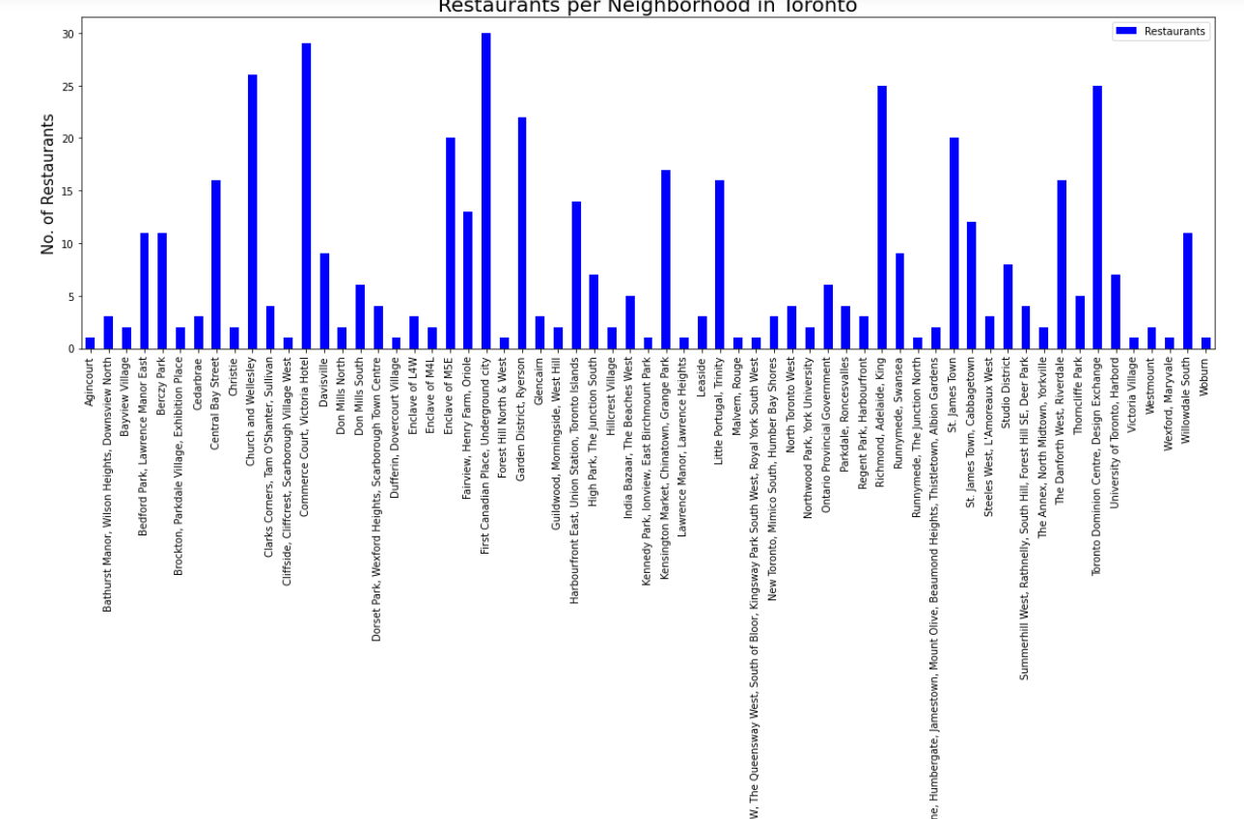
Number of Restaurants per Neighborhood
Downtown Toronto has highest number of restaurants, thus it is pretty much evident that the top five neighbourhoods with highest number of restaurants are from Downtown Toronto.

Slide 8
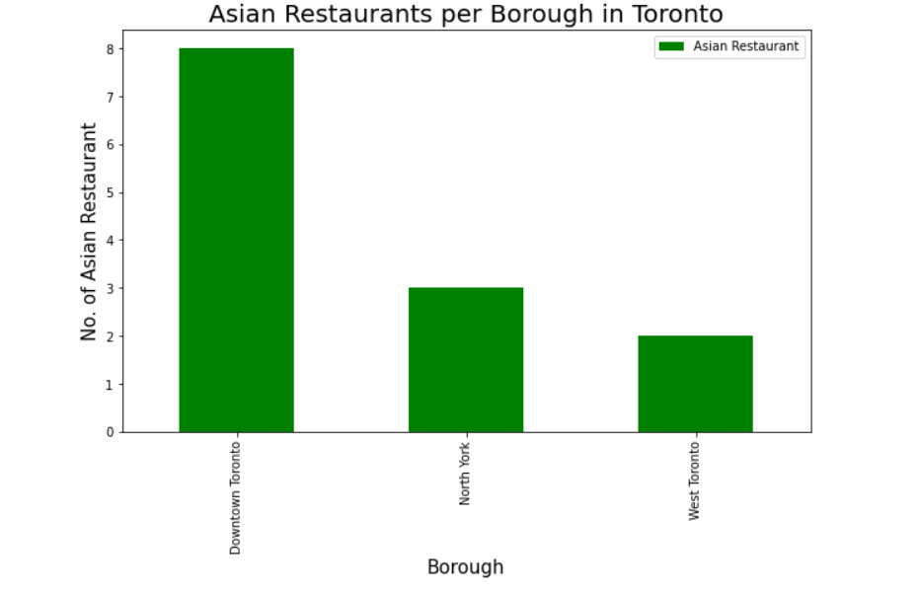
Number of Asian Restaurants per Borough
West Toronto is ideal location for establishing new Asian restaurant as it has only few options available. But it seems Downtown Toronto is popular amongst people for dining at Asian Restaurant as it has maximum number of them.

Slide 9
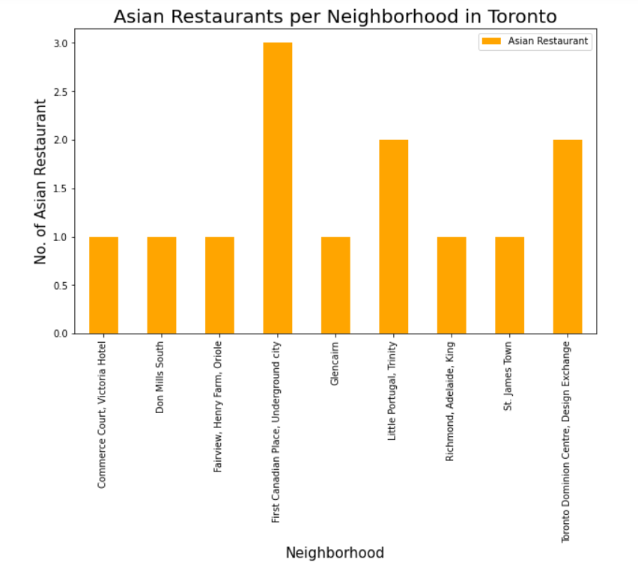
Number of Restaurants per Neighborhood
First Canadian Place is most popular for Asian Restaurants. So, if we are concerned with popularity of area, First Canadian Place, Underground City is ideal place to open new Asian Restaurant.
To avoid the competition, we can choose neighbourhood with least number of restaurants to provide people with new place to enjoy Asian cuisine. Some of the neighbourhoods are Commerce Court, Don Mills South, Fairview, Glencaim, St. James Town, etc.

Slide 10
Discussion
Based on the results of our analysis, Downtown Toronto have multiple neighbourhoods with good number of restaurants which suggests that people ideally choose any of the neighbourhoods from this borough for dining.
On the contrary, neighbourhood in West Toronto have good possibility for opening new Asian Restaurant as it has only few in the neighbourhood of Little Portugal Trinity. Thus, opening a new Asian Restaurant in West Toronto will provide people with another option to try Asian cuisines.

Slide 11
Conclusion
In this project, we have performed
Data extraction,
Data pre-processing –transformed extracted data into dataframes, filtered required data, merged different dataframes
Performed analysis on filtered data
Recommendations based on the analysis.
Used different python libraries to perform the task.
The findings of this project will help investors to understand in a better way, the advantages and disadvantages of different boroughs and neighbourhoods of Toronto in order to open new Asian Restaurant.

